Slide 1

Slide 10- <number>

Slide 2
Chapter 10
Functional Dependencies and Normalization for Relational Databases
Copyright © 2007 Ramez Elmasri and Shamkant B. Navathe

Slide 3
Chapter Outline
1 Informal Design Guidelines for Relational Databases
2 Functional Dependencies (FDs)
  2.1 Definition of FD
  2.2 Inference Rules for FDs
  2.3 Equivalence of Sets of FDs
  2.4 Minimal Sets of FDs
  3 Normalization of relations
  4 Normal forms
Slide 10- <number>

Slide 4
1 Informal Design Guidelines for Relational Databases (1)
What is relational database design?
  The grouping of attributes to form "good" relation schemas
Design is concerned mainly with base relations
What are the criteria for "good" base relations?
Slide 10- <number>

Slide 5
Informal Design Guidelines for Relational Databases (2)
We first discuss informal guidelines for good relational design
Then we discuss formal concepts of functional dependencies and normal forms
  - 1NF (First Normal Form)
  - 2NF (Second Normal Form)
  - 3NF (Third Normal Form)
  - BCNF (Boyce-Codd Normal Form)
Slide 10- <number>

Slide 6
1.1 Semantics of the Relation Attributes
GUIDELINE 1: Informally, each tuple in a relation should represent one entity or relationship instance. (Applies to individual relations and their attributes).
  Attributes of different entities (EMPLOYEEs, DEPARTMENTs, PROJECTs) should not be mixed in the same relation
  Only foreign keys should be used to refer to other entities
  Entity and relationship attributes should be kept apart as much as possible.
Bottom Line: Design a schema that can be explained easily relation by relation. The semantics of attributes should be easy to interpret.
Slide 10- <number>

Slide 7
1.2 Redundant Information in Tuples and Update Anomalies
Information is stored redundantly
  Wastes storage
  Causes problems with update anomalies
    Insertion anomalies
    Deletion anomalies
    Modification anomalies
Slide 10- <number>

Slide 8
EXAMPLE OF AN UPDATE ANOMALY
Consider the relation:
  EMP_PROJ(Emp#, Proj#, Ename, Pname, No_hours)
E1 P1 AA Billing 100
Update Anomaly:
  Changing the name of project number P1 from “Billing” to “Customer-Accounting” may cause this update to be made for all 100 employees working on project P1.
Slide 10- <number>

Slide 9
EXAMPLE OF AN INSERT ANOMALY
Consider the relation:
  EMP_PROJ(Emp#, Proj#, Ename, Pname, No_hours)
E1 P1 AA Billing 100
Insert Anomaly:
  Cannot insert a project unless an employee is assigned to it.
Conversely
  Cannot insert an employee unless an he/she is assigned to a project.
Slide 10- <number>

Slide 10
EXAMPLE OF AN DELETE ANOMALY
Consider the relation:
  EMP_PROJ(Emp#, Proj#, Ename, Pname, No_hours)
E1 P1 AA Billing 100
Delete Anomaly:
  When a project is deleted, it will result in deleting all the employees who work on that project.
  Alternately, if an employee is the sole employee on a project, deleting that employee would result in deleting the corresponding project.
Slide 10- <number>

Slide 11
Guideline to Redundant Information in Tuples and Update Anomalies
GUIDELINE 2:
  Design a schema that does not suffer from the insertion, deletion and update anomalies.
  If there are any anomalies present, then note them so that applications can be made to take them into account.
Slide 10- <number>

Slide 12
1.3 Null Values in Tuples
GUIDELINE 3:
  Relations should be designed such that their tuples will have as few NULL values as possible
  Attributes that are NULL frequently could be placed in separate relations (with the primary key)
Reasons for nulls:
  Attribute not applicable or invalid
  Attribute value unknown (may exist)
  Value known to exist, but unavailable
Slide 10- <number>

Slide 13
1.4 Spurious Tuples
Bad designs for a relational database may result in erroneous results for certain JOIN operations
The "lossless join" property is used to guarantee meaningful results for join operations
GUIDELINE 4:
  The relations should be designed to satisfy the lossless join condition.
  No spurious tuples should be generated by doing a natural-join of any relations.
Slide 10- <number>

Slide 14
Spurious Tuples (2)
There are two important properties of decompositions:
  Non-additive or losslessness of the corresponding join
  Preservation of the functional dependencies.
Note that:
  Property (a) is extremely important and cannot be sacrificed.
  Property (b) is less stringent and may be sacrificed.
Slide 10- <number>

Slide 15
2.1 Functional Dependencies (1)
Functional dependencies (FDs)
  Are used to specify formal measures of the "goodness" of relational designs
  And keys are used to define normal forms for relations
  Are constraints that are derived from the meaning and interrelationships of the data attributes
A set of attributes X functionally determines a set of attributes Y if the value of X determines a unique value for Y. It denotes by X → Y
Slide 10- <number>

Slide 16
Functional Dependencies (2)
X → Y holds if whenever two tuples have the same value for X, they must have the same value for Y
  For any two tuples t1 and t2 in any relation instance r(R): If t1[X]=t2[X], then t1[Y]=t2[Y]
X → Y in R specifies a constraint on all relation instances r(R)
FDs are derived from the real-world constraints on the attributes.
α → β is trivial if β ⊆ α
Slide 10- <number>

Slide 17
Examples of FD constraints (2)
The constraint must hold on every relation instance r(R)
If K is a key of R, then K functionally determines all attributes in R
  (since we never have two distinct tuples with t1[K]=t2[K])
Slide 10- <number>

Slide 18
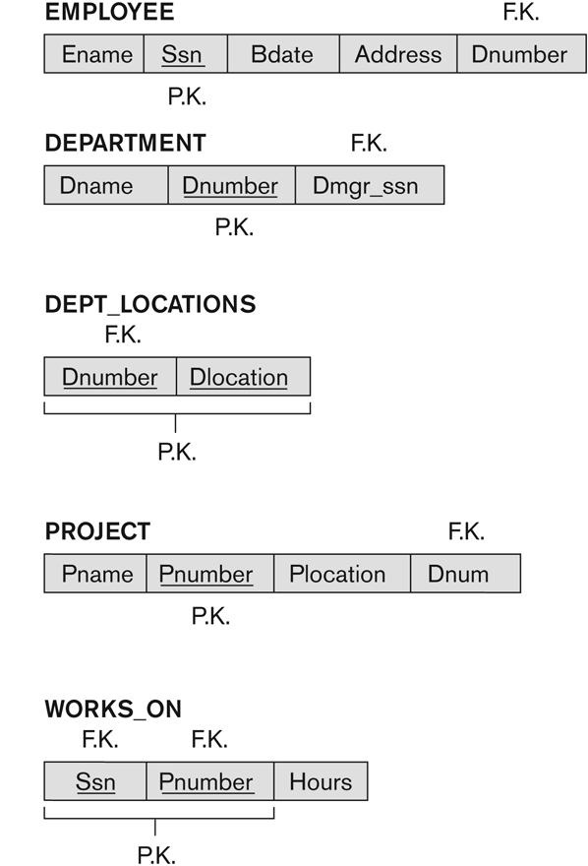
Example. A simplified COMPANY relational database schema
  SSN → ENAME
  {Dnumber, Dlocation} → Dlocation is trivial
  PNUMBER → {PNAME, PLOCATION}
  {SSN, PNUMBER} → HOURS
Slide 10- <number>

Slide 19
2.2 Inference Rules for FDs (1)
Given a set of FDs F, we can infer additional FDs that hold whenever the FDs in F hold
Armstrong's inference rules:
  IR1. (Reflexive) If Y ⊆ X, then X → Y
  IR2. (Augmentation) If X → Y, then XZ → YZ
    (Notation: XZ stands for X U Z)
  IR3. (Transitive) If X → Y and Y → Z, then X → Z
IR1, IR2, IR3 form a sound and complete set of inference rules
  These are rules hold and all other rules that hold can be deduced from these
Slide 10- <number>

Slide 20
Inference Rules for FDs (2)
Some additional inference rules that are useful:
  Decomposition: If X → YZ, then X → Y and X → Z
  Union: If X → Y and X → Z, then X → YZ
  Psuedotransitivity:
  If X → Y and WY → Z, then WX → Z
The last three inference rules, as well as any other inference rules, can be deduced from IR1, IR2, and IR3 (completeness property)
Slide 10- <number>

Slide 21
Closure of a Set of Functional Dependencies
Closure of a set F of FDs is the set F⁺ of all FDs that can be inferred from F. We denote the closure of F by F⁺
F ⊆ F⁺
Slide 10- <number>

Slide 22
Example
R = (A, B, C, G, H, I)
F = { A → B, A → C, CG → H, CG → I, B → H}
some members of F⁺
  A → H
    by transitivity from A → B and B → H
  AG → I
    by augmenting A → C with G, to get AG → CG
    and then transitivity with CG → I
  CG → HI
    by augmenting CG → I to infer CG → CGI,
    and augmenting of CG → H to infer CGI → HI,
    and then transitivity

Slide 23
Closure of Attribute Sets
Closure of a set of attributes X with respect to F (denoted by X⁺_{F}) is the set of all attributes that are functionally determined by X.
X⁺_{F} = {γ / α → γ ∈ F⁺}
X⁺_{F} can be calculated by repeatedly applying IR1, IR2, IR3 using the FDs in F
Algorithm to compute X⁺_{F}
result := α;
while (changes to result) do
for each β → γ in F do
begin
if β ⊆ result then result := result ∪ γ
end

Slide 24
Example of Attribute Set Closure
R = (A, B, C, G, H, I)
F = {A → B
A → C
CG → H
CG → I
B → H}
(AG)⁺
  1. result = AG
  2. result = ABCG (A → C and A → B)
  3. result = ABCGH (CG → H and CG ⊆ AGBC)
  4. result = ABCGHI (CG → I and CG ⊆ AGBCH)
Is AG a candidate key?
  Is AG a super key? Does AG → R? == Is (AG)⁺ ⊇ R
  Is any subset of AG a superkey?
    Does A → R? == Is (A)⁺ ⊇ R
    Does G → R? == Is (G)⁺ ⊇ R

Slide 25
Uses of Attribute Closure
There are several uses of the attribute closure algorithm:
Testing for superkey:
  To test if α is a superkey, we compute α^{+,} and check if α⁺ contains all attributes of R.
Testing functional dependencies
  To check if a functional dependency α → β holds (or, in other words, is in F⁺), just check if β ⊆ α⁺.
  That is, we compute α⁺ by using attribute closure, and then check
  if it contains β.
  Is a simple and cheap test, and very useful
Computing closure of F
  For each γ ⊆ R, we find the closure γ⁺, and for each S ⊆ γ⁺, we output a functional dependency γ → S.

Slide 26
2.3 Equivalence of Sets of FDs
Two sets of FDs F and G are equivalent if:
  Every FD in F can be inferred from G, and
  Every FD in G can be inferred from F
  Hence, F and G are equivalent if F⁺ =G⁺
Definition (Covers):
  F covers G if every FD in G can be inferred from F
    (i.e., if G⁺ subset-of F⁺)
F and G are equivalent if F covers G and G covers F
a minimal cover of a set of functional dependencies E is a minimal set of functional dependencies F that is equivalent to E.
We can always find at least one minimal cover F for any set of dependencies E
Slide 10- <number>

Slide 27
2.4 Minimal Sets of FDs (1)
A set of FDs is minimal if it satisfies the following conditions:
  Every dependency in F has a single attribute for its RHS.
  We cannot replace any dependency X → A in F with a dependency Y → A, where Y proper-subset-of X (Y subset-of X) and still have a set of dependencies that is equivalent to F.
  We cannot remove any dependency from F and have a set of dependencies that is equivalent to F.
Slide 10- <number>

Slide 28
Minimal Sets of FDs (2)
Every set of FDs has an equivalent minimal set
There can be several equivalent minimal sets
There is no simple algorithm for computing a minimal set of FDs that is equivalent to a set F of FDs
To synthesize a set of relations, we assume that we start with a set of dependencies that is a minimal set.
Slide 10- <number>

Slide 29
Algorithm for Finding a Minimal Cover F for a Set of Functional
Dependencies E
Input: A set of functional dependencies E.
1. Set F := E.
2. Replace each functional dependency X→{A1, A2, ..., An} in
F by the n functional dependencies X→A1, X→A2, ..., X→An.
3. For each functional dependency X→A in F for each attribute B
that is an element of X
if { {F – {X→A} } ∪ { (X – {B} ) →A} } is equivalent to F
then replace X→A with (X – {B} ) →A in F.
4. For each remaining functional dependency X→A in F
if {F – {X→A} } is equivalent to F,
then remove X→A from F.
Slide 10- <number>

Slide 30
Example 1. given set of FDs be E : {B→A, D→A, AB→D}. Find the minimal cover of E.
All above dependencies are in canonical form (that is, they have only one attribute on the right-hand side), so we have completed step 1 of Algorithm.
Determine if AB→D has any redundant attribute on the left-hand side; that is, can it be replaced by B→D or A→D?
We have B→AB (i) (from B →A => BB → AB)
AB→D as given (ii).
From (i) and (ii) => B → D. Thus AB→D may be replaced by B→D
We now have a set equivalent to original E, say E’ = {B→A, D→A, B→D}
In step 3 we look for a redundant FD in E.
From B → D and D → A => B → A. Hence B → A is redundant in E
The minimal cover of E is {B→D, D→A}.
Slide 10- <number>

Slide 31
Example 2. Given R = (A, B, C), F = {A → BC, B → C, A → B, AB → C}. Find the minimal cover of F.
Combine A → BC and A → B into A → BC
  Set is now {A → BC, B → C, AB → C}
A is extraneous in AB → C
  Check if the result of deleting A from AB → C is implied by the other dependencies
    Yes: in fact, B → C is already present!
  Set is now {A → BC, B → C}
C is extraneous in A → BC
  Check if A → C is logically implied by A → B and the other dependencies
    Yes: using transitivity on A → B and B → C.
      Can use attribute closure of A in more complex cases
The minimal cover of F is: {A → B, B → C}

Slide 32
Key definition based on FD
Given R(A₁, A₂, . . ., A_{n}) and a FD set F
  + S ⊆ R is a superkey of R if S → R ∈ F⁺
  + K ⊆ R is one of candidate keys of R if:
- K is a superkey
  - for no α ⊂ K, α → R

Slide 33
Algorithm for Finding a Key K for R Given a set F of Functional
Dependencies
Input: A relation R and a set of functional dependencies F on the attributes of R.
1. Set K := R.
2. For each attribute A in K
{compute (K – A)+ with respect to F;
if (K – A)+ contains all the attributes in R,
then set K := K – {A} };
Notice, this algorithm determines only one key out of the possible candidate keys for R; the key returned depends on the order in which attributes are removed from R in step 2.
Slide 10- <number>

Slide 34
Algorithm for Finding all candidate keys for R
Input: Given a set R of attributes and a set F of FD
Output: A set K of candidate keys of R
Phase 1:
Find a set S of all super keys of R
S = {s_{i} / s_{i} → R }
by computing closures of (2^{n} -1) not null subsets of R. if a closure of any subset is equal to R that subset is a super key of R.
Phase 2 :
Find a set K of all candidate keys from the super key set by removing any super key that is not minimum

Slide 35
Algorithm for Finding all candidate keys for R (cont.)
Example: Given Q(R), R = {A, B, C, D, E, G} and
F = { f1: AE → C, f2 : CG → A, f3 : BD → G, f4: GA → E}
Find all candidate keys of Q(R).
- Phase 1:
computing closures of (2^{n} -1) not null subsets of R.
Note: if ABD is a super key then any set S ⊇ ABD is also a super key.
ABCDEG | X ⊆ R | X⁺_{F} | Siêu khóa
000001 | G | G
110100 | ABD | ABCDEG | ABD
...
110110 | ABDE |  | ABDE

Slide 36
Algorithm for Finding all candidate keys for R (cont.)
- The result of phase 1:
S = { ABD, BCD, ABCD, ABDE, BCDE, ABCDE, ABDG, BCDG, ABCDG, ABDEG, BCDEG, ABCDEG}
- The result of phase 2 : choose minimum sets in S.
K = { ABD, BDC}

Slide 37
Improved Algorithm for Finding all candidate keys for R
Comment:
If R is large, it takes a long time for computing closures of (2^{n} –1) subsets of R.
The above algorithm is improved as follows:
Given A ∈ R,
- A is called a source attribute if A is not in the right hand side of any non trivial FD of F
The set of all source attributes denotes by N
- A is called a destination attribute if A is not a source attribute and A is not in the left hand side of any non trivial FD of F.
The set of all destination attributes denotes by D.

Slide 38
Improved Algorithm for Finding all candidate keys for R
- The set of attributes which are not source or destination attributes denotes by L.
We have R = N U D U L và N , D , L are disjoined
- Note:
+ If K is a key of Q, K includes all source attributes and does not include any destination attribute.
So K = N U Li , Li ⊆ L
K ∩ D = ∅
+ If X_{i} is a super key and X_{i} ⊂ X_{j}, we need not to compute closure of X_{j} because it is not a candidate key of Q.

Slide 39
Improved Algorithm for Finding all candidate keys for R
Example: Given Q(R), R = {A, B, C, D, E, G} và
F = { f1: AE → C, f2 : CG → A, f3 : BD → G, f4: GA → E}
Find all candidate keys of Q
N = {B,D}, D= φ, L = {A,C, E, G}
- Phase 1:
Compute closure of subsets of R.
Note: if ABD is a super key, X ⊃ ABC is also a super key.
L = ACEG | X= N U li ∈ L | X⁺_{F} | Siêu khóa
0000 | BD
0001 | BDG

Slide 40
3. Normalization of Relations
Normalization:
  The process of decomposing unsatisfactory "bad" relations by breaking up their attributes into smaller relations
Normal form:
  Condition using keys and FDs of a relation to certify whether a relation schema is in a particular normal form
Slide 10- <number>

Slide 41
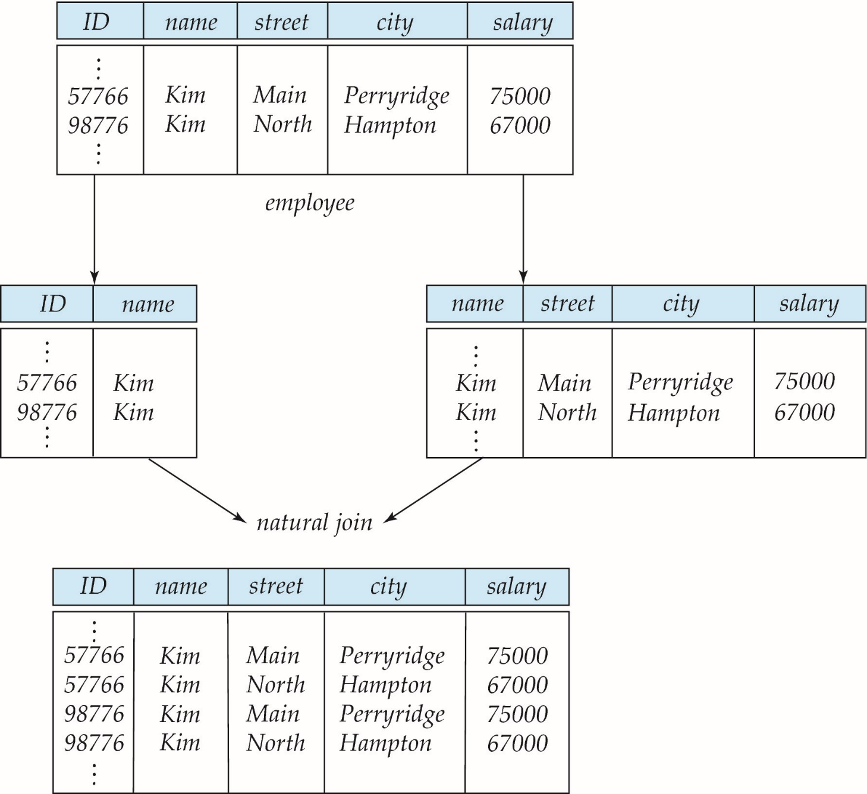
A Lossy Decomposition
we cannot reconstruct the original employee relation -- we lose information

Slide 42
Example of Lossless-Join Decomposition
Lossless join decomposition
Decomposition of R = (A, B, C)
R₁ = (A, B) R₂ = (B, C)
A
B
C
A
B
B
C
α
β
1
2
A
B
α
β
1
2
1
2
A
B
r
∏_{A,B}(r)
∏_{B,C}(r)
∏_{A} (r) ∏_{B} (r)
A
B
C
α
β
1
2
A
B

Slide 43
Nonadditive/Lossless-join Decomposition
A decomposition R into {R₁, R₂, ..., R_{n}} is Lossless-join if
r = ∏_{R1} (r ) ∏_{R2} (r ) … ∏_{Rn} (r )
For the case of R = (R₁, R₂), we require that for all possible relations r on schema R
r = ∏_{R1} (r ) ∏_{R2} (r )
A decomposition of R into R₁ and R₂ is lossless join if at least one of the following dependencies is in F⁺:
  R₁ ∩ R₂ → R₁
  R₁ ∩ R₂ → R₂
The above functional dependencies are a sufficient condition for lossless join decomposition; the dependencies are a necessary condition only if all constraints are functional dependencies

Slide 44
Testing for Nonadditive Join (1)
Input: A universal relation R, a decomposition D = {R₁, R₂, ..., R_{m}} of R, and a set F of functional dependencies.
1. Create an initial matrix S with one row i for each relation R_{i} in D, and one
column j for each attribute A_{j} in R.
2. Set S(i, j):= bij for all matrix entries.
3. For each row i representing relation schema R_{i}
for each column j representing attribute A_{j}
if (relation R_{i} includes attribute A_{j}) then set S(i, j):= a_{j}

Slide 45
Testing for Nonadditive Join (2)
4. Repeat the following loop until a complete loop execution results in no
changes to S:
for each functional dependency X→Y in F
for all rows in S that have the same symbols in the columns
corresponding to attributes in X
make the symbols in each column that correspond to an attribute in
Y be the same in all these rows as follows: If any of the rows has
an ‘a’ symbol for the column, set the other rows to that same ‘a’
symbol in the column. If no ‘a’ symbol exists for the attribute in any
of the rows, choose one of the ‘b’ symbols that appears in one of
the rows for the attribute and set the other rows to that same ‘b’
symbol in the column.
5. If a row is made up entirely of ‘a’ symbols, then the decomposition has the
nonadditive join property; otherwise, it does not.

Slide 46
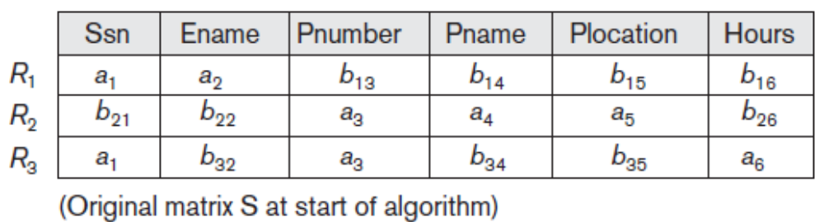
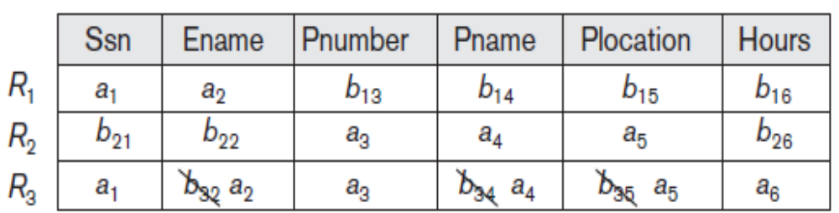
Example
R = {Ssn, Ename, Pnumber, Pname, Plocation, Hours}, D = {R1, R2, R3}
R1 = EMP(Ssn, Ename), R2 = PROJ(Pnumber, Pname, Plocation)
R3 = WORKS_ON(Ssn, Pnumber, Hours).
F = {Ssn→Ename; Pnumber→{Pname, Plocation}; {Ssn, Pnumber}→Hours}
Applying Ssn→Ename and Pnumber→{Pname, Plocation}
last row is all “a” symbols so we stop

Slide 47
Dependency Preservation
Let F_{i} be the set of dependencies F ⁺ that include only attributes in R_{i}.
    A decomposition is dependency preserving, if
    (F₁ ∪ F₂ ∪ … ∪ F_{n} )⁺ = F ⁺
    If it is not, then checking updates for violation of functional dependencies may require computing joins, which is expensive.

Slide 48

Example
R = (A, B, C)
F = {A → B, B → C)
  Can be decomposed in two different ways
R₁ = (A, B), R₂ = (B, C)
  Lossless-join decomposition:
  R₁ ∩ R₂ = {B} and B → BC
  Dependency preserving
R₁ = (A, B), R₂ = (A, C)
  Lossless-join decomposition:
  R₁ ∩ R₂ = {A} and A → AB
  Not dependency preserving
  (cannot check B → C without computing R₁ R₂)

Slide 49
Testing for Dependency Preservation
To check if a dependency α → β is preserved in a decomposition of R into R₁, R₂, …, R_{n} we apply the following test (with attribute closure done with respect to F)
  result = α
  Repeat
  for each R_{i} in the decomposition
  t = (result ∩ R_{i})⁺ ∩ R_{i}
  result = result ∪ t
  Until (result does not change)
  If result contains all attributes in β, then the functional dependency α → β is preserved.
We apply the test on all dependencies in F to check if a decomposition is dependency preserving
This procedure takes polynomial time, instead of the exponential time required to compute F⁺ and (F₁ ∪ F₂ ∪ … ∪ F_{n})⁺

Slide 50
Goals of Normalization
Let R be a relation scheme with a set F of functional dependencies.
Decide whether a relation scheme R is in “good” form.
In the case that a relation scheme R is not in “good” form, decompose it into a set of relation scheme {R₁, R₂, ..., R_{n}} such that
  each relation scheme is in good form
  the decomposition is a lossless-join decomposition
  Preferably, the decomposition should be dependency preserving.

Slide 51
4.1. First Normal Form
4. Normal Forms
Attribute values permitted by 1NF are single atomic (or indivisible) values.
Considered to be part of the definition of relation
Slide 10- <number>

Slide 52

Example. Normalization into 1NF
Slide 10- <number>

Slide 53
4.2. Second Normal Form (1)
Uses the concepts of FDs, primary key
Definitions
  Prime attribute: An attribute of relation schema R that is member of some candidate key of R
  Full functional dependency: a FD Y → Z where removal of any attribute from Y means the FD does not hold any more
Examples:
  {SSN, PNUMBER} → HOURS is a full FD since neither SSN → HOURS nor PNUMBER → HOURS hold
  {SSN, PNUMBER} → ENAME is not a full FD (it is called a partial dependency ) since SSN → ENAME also holds
Slide 10- <number>

Slide 54
Second Normal Form (2)
A relation schema R is in second normal form (2NF) if every non-prime attribute A in R is fully functionally dependent on every key of R
R can be decomposed into 2NF relations via the process of 2NF normalization
Slide 10- <number>

Slide 55
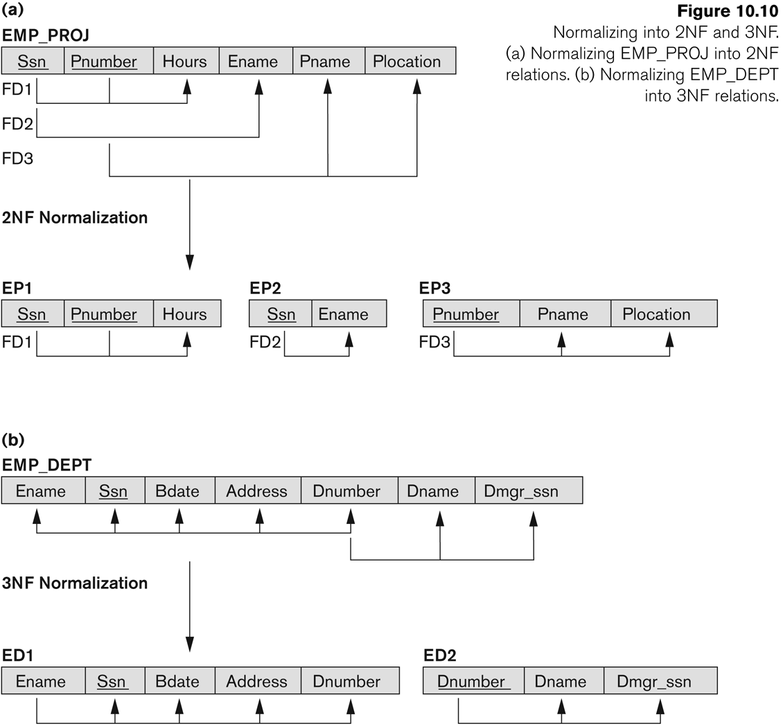
4.3. Third Normal Form (1)
Definition:
  Transitive functional dependency: a FD X → Z that can be derived from two FDs X → Y and Y → Z
Examples:
  SSN → DMGRSSN is a transitive FD
    Since SSN → DNUMBER and DNUMBER → DMGRSSN hold
  SSN → ENAME is non-transitive
    Since there is no set of attributes X where SSN → X and X -> ENAME
Slide 10- <number>

Slide 56
Third Normal Form (2)
A relation schema R is in third normal form (3NF) if it is in 2NF and no non-prime attribute A in R is transitively dependent on the primary key
R can be decomposed into 3NF relations via the process of 3NF normalization
NOTE:
  In X → Y and Y → Z, with X as the primary key, we consider this a problem only if Y is not a candidate key.
  When Y is a candidate key, there is no problem with the transitive dependency .
  E.g., Consider EMP (SSN, Emp#, Salary ).
    Here, SSN → Emp# → Salary and Emp# is a candidate key.
Slide 10- <number>

Slide 57
Third Normal Form (3)
alternative definition:
  A relation schema R is in third normal form (3NF) if whenever a FD X → A holds in R, then either:
    (a) X is a superkey of R, or
    (b) A is a prime attribute of R
    (c) X → A is trivial (i.e., A ∈ X)
NOTE: Boyce-Codd normal form disallows condition (b) above
Slide 10- <number>

Slide 58
Example. Normalizing into 2NF and 3NF (1)
Slide 10- <number>

Slide 59
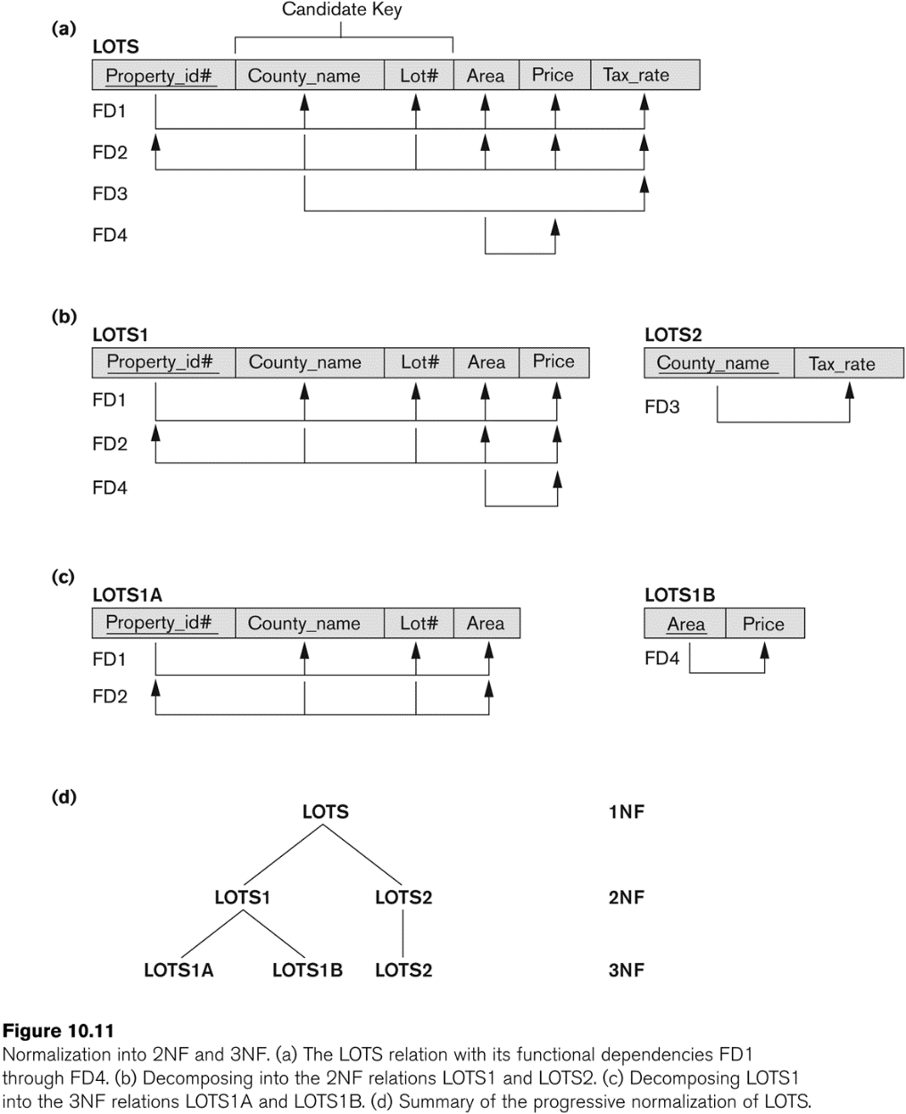
Example. Normalization into 2NF and 3NF (2)
Slide 10- <number>

Slide 60
3NF Decomposition Algorithm
Let F_{c} be a canonical cover for F;
i := 0;
for each functional dependency α → β in F_{c} do
if none of the schemas R_{j}, 1 ≤ j ≤ i contains α β
then begin
i := i + 1;
R_{i} := α β
end
if none of the schemas R_{j}, 1 ≤ j ≤ i contains a candidate key for R
then begin
i := i + 1;
R_{i} := any candidate key for R;
end
/* Optionally, remove redundant relations */
repeat
if any schema R_{j} is contained in another schema R_{k}
then /* delete R_{j} */
R_{j} = R_{i}
i=i-1;
until no more Rjs can be deleted
return (R₁, R₂, ..., R_{i})
  Note: Above algorithm ensures decomposition is dependency preserving and lossless-join

Slide 61
3NF Decomposition: An Example
Relation schema:
cust_banker_branch(customer_id, employee_id, branch_name, type )
The functional dependencies for this relation schema are:
  customer_id, employee_id → branch_name, type
  employee_id → branch_name
  customer_id, branch_name → employee_id
We first compute a canonical cover
  branch_name is extraneous in the right hand side of the 1st dependency
  No other attribute is extraneous, so we get F_{C} =
  customer_id, employee_id → type
  employee_id → branch_name
  customer_id, branch_name → employee_id

Slide 62
3NF Decompsition Example (Cont.)
The for loop generates following 3NF schema:
R1(customer_id, employee_id, type )
R2 (employee_id, branch_name)
R3 (customer_id, branch_name, employee_id)
  Observe that (customer_id, employee_id, type ) contains a candidate key of the original schema, so no further relation schema needs be added
At end of for loop, detect and delete schemas, such as (employee_id, branch_name), which are subsets of other schemas
  result will not depend on the order in which FDs are considered
The resultant simplified 3NF schema is:
R1(customer_id, employee_id, type)
R2(customer_id, branch_name, employee_id)

Slide 63
4.4. BCNF (Boyce-Codd Normal Form)
A relation schema R is in Boyce-Codd Normal Form (BCNF) if whenever an FD X → A holds in R, then X is a superkey of R
Each normal form is strictly stronger than the previous one
  Every 2NF relation is in 1NF
  Every 3NF relation is in 2NF
  Every BCNF relation is in 3NF
There exist relations that are in 3NF but not in BCNF
The goal is to have each relation in BCNF (or 3NF)
Example schema not in BCNF:
instr_dept (ID, name, salary, dept_name, building, budget )
because dept_name→ building, budget
holds on instr_dept, but dept_name is not a superkey
Slide 10- <number>

Slide 64
Decomposing a Schema into BCNF
Suppose we have a schema R and a non-trivial dependency α →β causes a violation of BCNF.
We decompose R into:
  (α U β )
  ( R - ( β - α ) )
In our example,
instr_dept (ID, name, salary, dept_name, building, budget )
  α = dept_name
  β = building, budget
  and inst_dept is replaced by
  R1( dept_name, building, budget )
  R2( ID, name, salary, dept_name )

Slide 65
BCNF and Dependency Preservation
Constraints, including functional dependencies, are costly to check in practice unless they pertain to only one relation
If it is sufficient to test only those dependencies on each individual relation of a decomposition in order to ensure that all functional dependencies hold, then that decomposition is dependency preserving.
Because it is not always possible to achieve both BCNF and dependency preservation, we consider a weaker normal form, known as third normal form.

Slide 66
Testing for BCNF
To check if a non-trivial dependency α →β causes a violation of BCNF
  1. compute α⁺ (the attribute closure of α), and
  2. verify that it includes all attributes of R, that is, it is a superkey of R.
Simplified test: To check if a relation schema R is in BCNF, it suffices to check only the dependencies in the given set F for violation of BCNF, rather than checking all dependencies in F⁺.
  If none of the dependencies in F causes a violation of BCNF, then none of the dependencies in F⁺ will cause a violation of BCNF either.
However, simplified test using only F is incorrect when testing a relation in a decomposition of R
  Consider R = (A, B, C, D, E), with F = { A → B, BC → D}
    Decompose R into R₁ = (A,B) and R₂ = (A,C,D, E)
    Neither of the dependencies in F contain only attributes from
    (A,C,D,E) so we might be mislead into thinking R₂ satisfies BCNF.
    In fact, dependency AC → D in F⁺ shows R₂ is not in BCNF.

Slide 67
Testing Decomposition for BCNF
To check if a relation R_{i} in a decomposition of R is in BCNF,
  Either test R_{i} for BCNF with respect to the restriction of F to R_{i} (that is, all FDs in F⁺ that contain only attributes from R_{i})
  or use the original set of dependencies F that hold on R, but with the following test:
      for every set of attributes α ⊆ R_{i}, check that α⁺ (the attribute closure of α) either includes no attribute of R_{i}- α, or includes all attributes of R_{i}.
    If the condition is violated by some α → β in F, the dependency
    α → (α⁺ - α ) ∩ R_{i}
    can be shown to hold on R_{i}, and R_{i} violates BCNF.
    We use above dependency to decompose R_{i}

Slide 68
Example of BCNF Decomposition (1)
class (course_id, title, dept_name, credits, sec_id, semester, year, building, room_number, capacity, time_slot_id)
Functional dependencies:
  course_id→ title, dept_name, credits
  building, room_number→capacity
  course_id, sec_id, semester, year→building, room_number, time_slot_id
A candidate key {course_id, sec_id, semester, year}.
BCNF Decomposition:
  course_id→ title, dept_name, credits holds
    but course_id is not a superkey.
  We replace class by:
    course(course_id, title, dept_name, credits)
    class-1 (course_id, sec_id, semester, year, building,
    room_number, capacity, time_slot_id)

Slide 69
Example of BCNF Decomposition (2)
course is in BCNF
  How do we know this?
building, room_number→capacity holds on class-1
  but {building, room_number} is not a superkey for class-1.
  We replace class-1 by:
    classroom (building, room_number, capacity)
    section (course_id, sec_id, semester, year, building, room_number, time_slot_id)
classroom and section are in BCNF.

Slide 70
BCNF and Dependency Preservation
It is not always possible to get a BCNF decomposition that is dependency preserving
R = (J, K, L )
F = {JK → L
L → K }
Two candidate keys = JK and JL
R is not in BCNF
Any decomposition of R will fail to preserve
JK → L
This implies that testing for JK → L requires a join

Slide 71
Comparison of BCNF and 3NF
It is always possible to decompose a relation into a set of relations that are in 3NF such that:
  the decomposition is lossless
  the dependencies are preserved
It is always possible to decompose a relation into a set of relations that are in BCNF such that:
  the decomposition is lossless
  it may not be possible to preserve dependencies.

Slide 72
Design Goals
Goal for a relational database design is:
  BCNF.
  Lossless join.
  Dependency preservation.
If we cannot achieve this, we accept one of
  Lack of dependency preservation
  Redundancy due to use of 3NF
Interestingly, SQL does not provide a direct way of specifying functional dependencies other than superkeys.
Can specify FDs using assertions, but they are expensive to test, (and currently not supported by any of the widely used databases!)
Even if we had a dependency preserving decomposition, using SQL we would not be able to efficiently test a functional dependency whose left hand side is not a key.

Slide 73
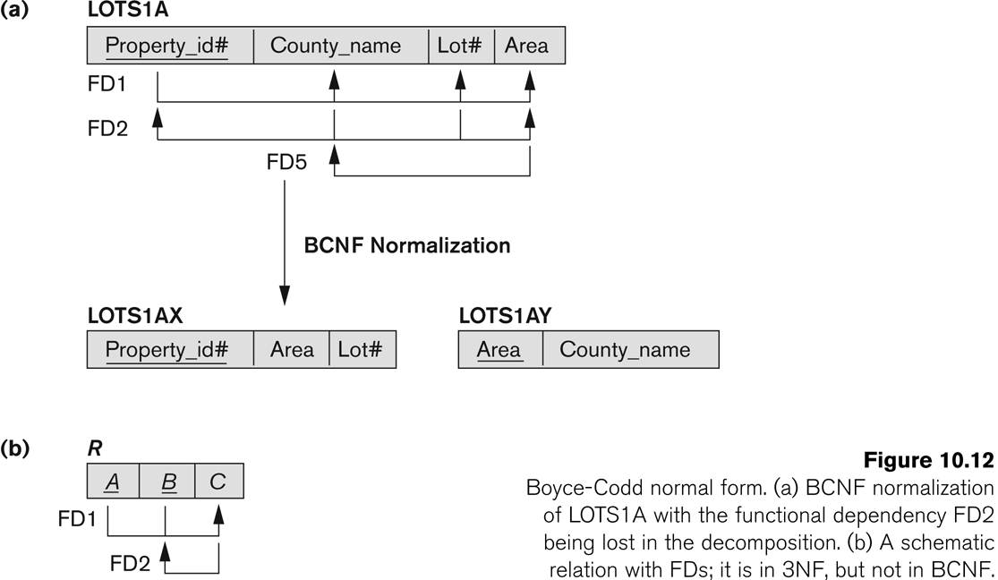
Example a Boyce-Codd normal form but Lack of dependency preservation
Slide 10- <number>

Slide 74
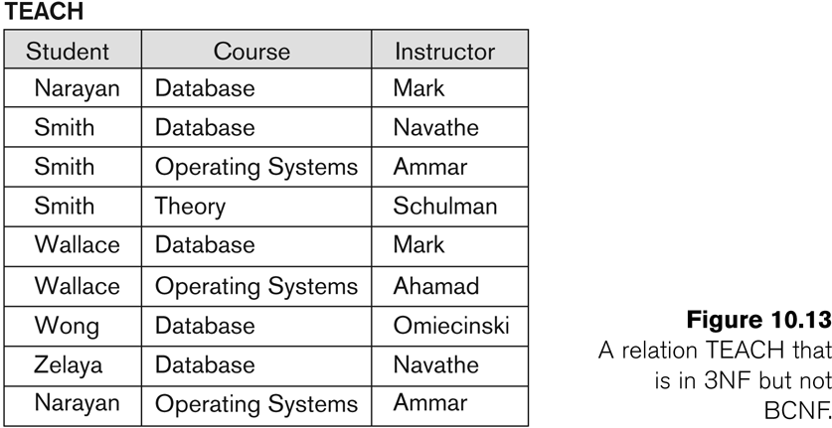
Example. A relation TEACH that is in 3NF but not in BCNF
Slide 10- <number>

Slide 75
Achieving the BCNF by Decomposition (1)
Two FDs exist in the relation TEACH:
  fd1: { student, course} -> instructor
  fd2: instructor -> course
{student, course} is a candidate key for this relation and that the dependencies shown follow the pattern in Figure 10.12 (b).
  So this relation is in 3NF but not in BCNF
A relation NOT in BCNF should be decomposed so as to meet this property, while possibly forgoing the preservation of all functional dependencies in the decomposed relations.
  (See Algorithm 11.3)
Slide 10- <number>

Slide 76
Achieving the BCNF by Decomposition (2)
Three possible decompositions for relation TEACH
  {student, instructor} and {student, course}
  {course, instructor } and {course, student}
  {instructor, course } and {instructor, student}
All three decompositions will lose fd1.
  We have to settle for sacrificing the functional dependency preservation. But we cannot sacrifice the non-additivity property after decomposition.
Out of the above three, only the 3rd decomposition will not generate spurious tuples after join.(and hence has the non-additivity property).
A test to determine whether a binary decomposition (decomposition into two relations) is non-additive (lossless) is discussed in section 11.1.4 under Property LJ1. Verify that the third decomposition above meets the property.
Slide 10- <number>

Slide 77
End of chapter 6
Slide 10- <number>

